Slide 1
Gun & Gun-related crime
Group D
Archit Dixit
Biran Li
Chou | Cheong
Notes:
FONT size

Slide 2

Overview
In this paper, comprehensive data analysis is performed using hive, excel 3D map and pie chart. All the above methods used for analysis comprises of Big Data platform. Hence this paper uses Big Data platform to keep the analyze gun-related crime data set, then the analysis result is visualized. We will use apache hive and pig to filter and analysis the relationship between gun sales rate, gun ownership and crime rate for recent two years. By using this data we can analyze the results and see the current situation of gun utilization.

Slide 3
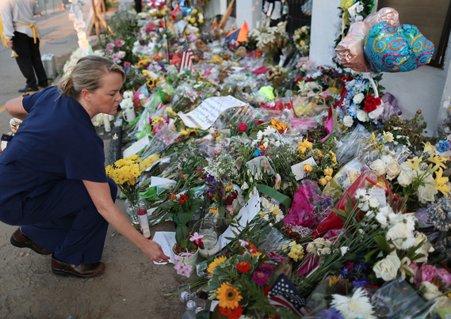
Deadliest U.S. mass shootings
June 12, 2016 50 killed, 53 injured in Orlando nightclub
Dec. 2nd, 2015 14 dead, 22 wounded in San Bernardino,CA
Nov. 29th, 2015 3 dead, 9 injured in Colorado Springs, Colo.
Oct. 1st, 2015 9 dead, 9 injured in Roseburg, Oregon.
July 16th, 2015 5 dead, 3 wounded in Chattanooga, Tenn
June 18th, 2015 9 dead in Charleston,
Sources from Los Angeles Times.

Slide 4







Tools
Putty(windows)
Terminal(iOS)
Ambari

Slide 5
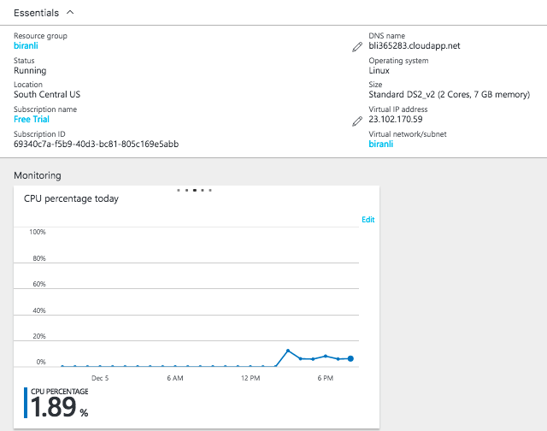
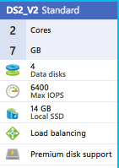
Data Specifications & Configuration
2 Nodes

Slide 6
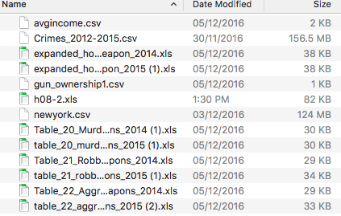
Data size
more than 150MB

Slide 7
Workflow
Data research & cleaning
Create Visuals using Tableau, MS Excel 3D map.
Load data in local file system using Command Prompt(windows) and Terminal(iOS)
Export Query results to MS Excel
Data loading in HDFS
Creating tables in Hive & Pig
Querying Data in Hive & Pig

Slide 8
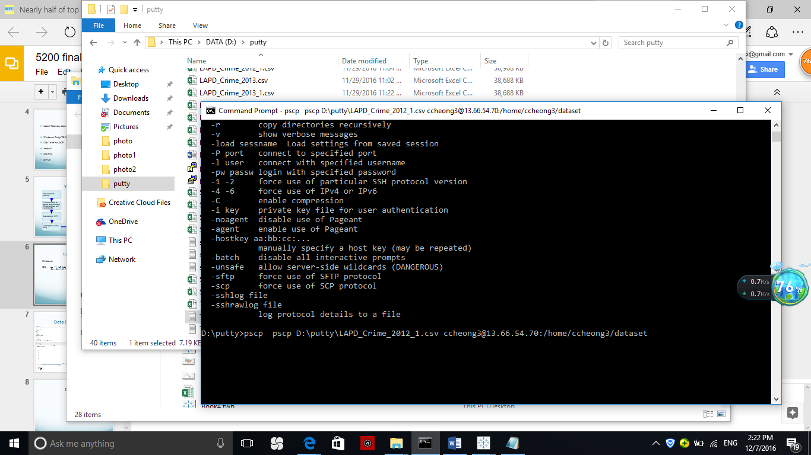
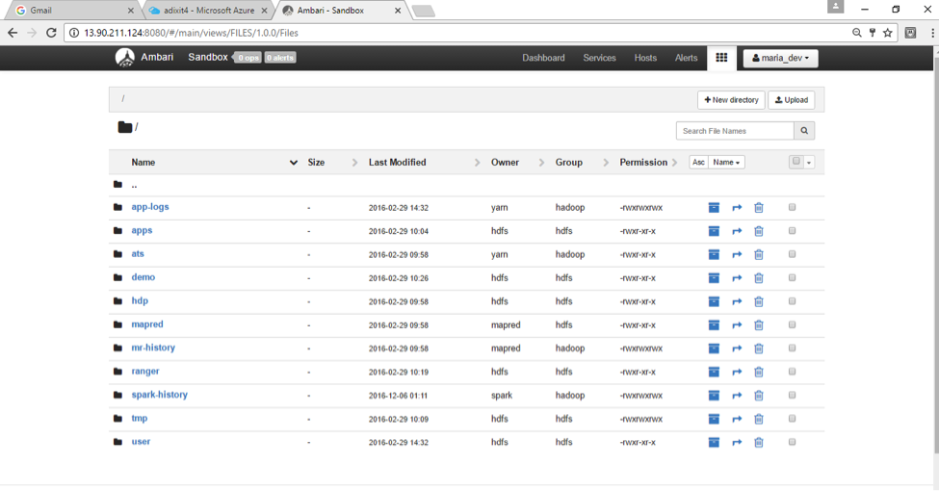
Upload CSV.file
Windows:
iOS:
Ambari:

Slide 9
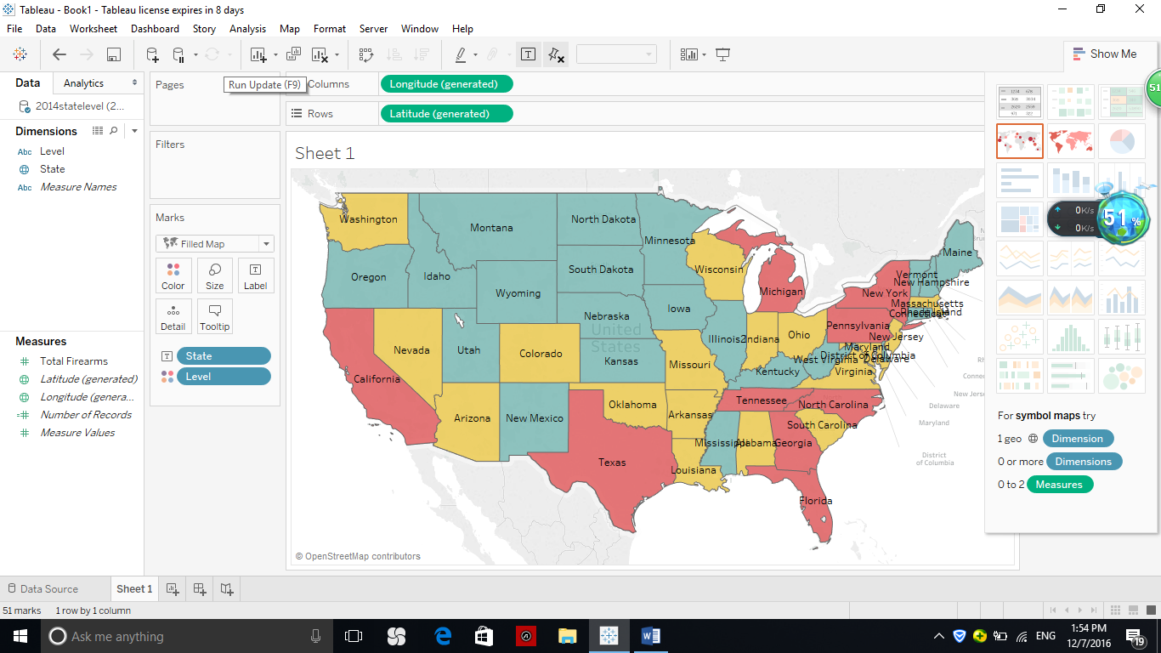
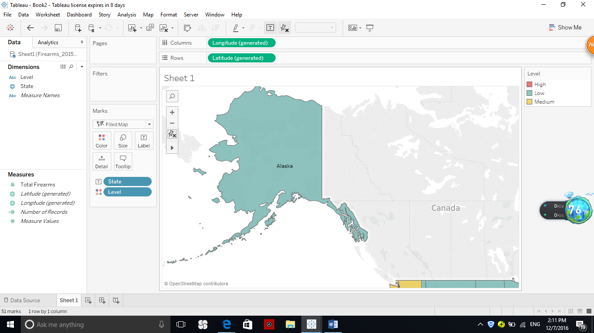
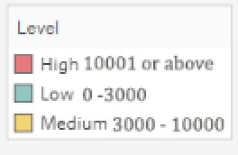
Gun Related Crime in 2014
Source from California Department of Justice, FBI

Slide 10
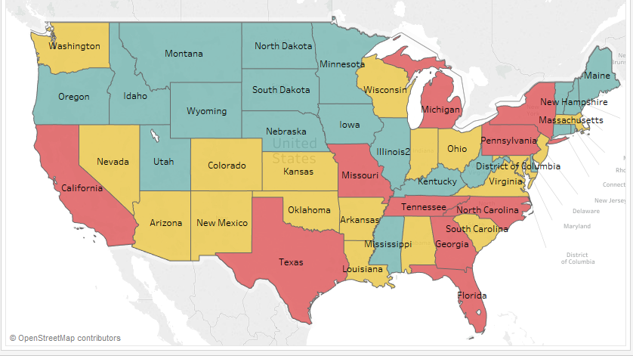
Gun Related Crime in 2015
Source from California Department of Justice, FBI

Slide 11
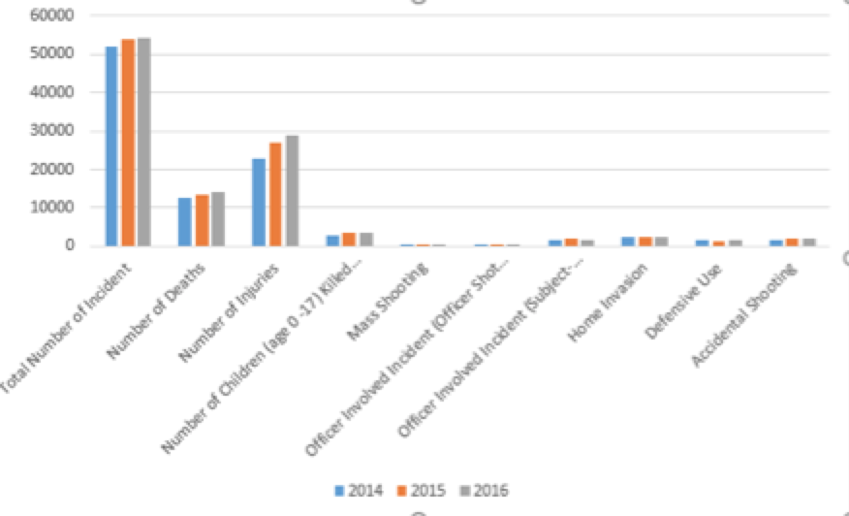
Gun Incident in 2014 -2016
Source from Gun Violence Archive.org

Slide 12
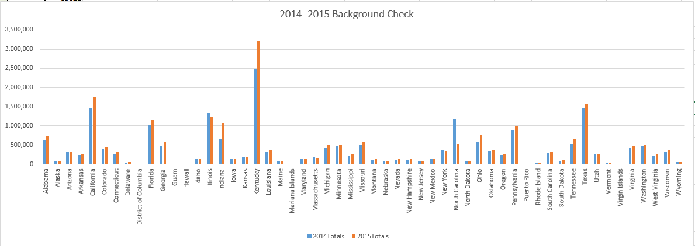
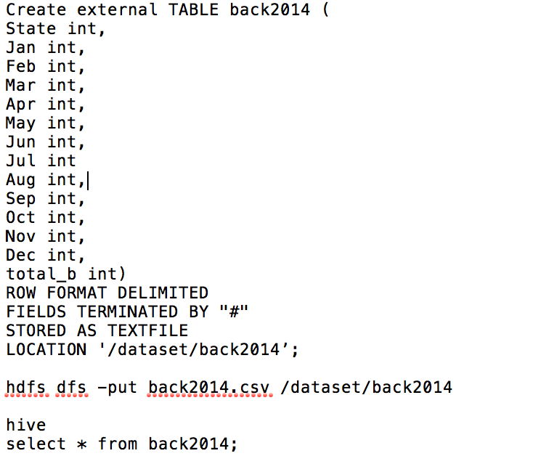
Gun Background Check Rate 2014 & 2015
Source from National Instant Criminal Background Check SystemNICS) FBI

Slide 13
Gun Related Crime in 2015
Source from California Department of Justice, FBI

Slide 14
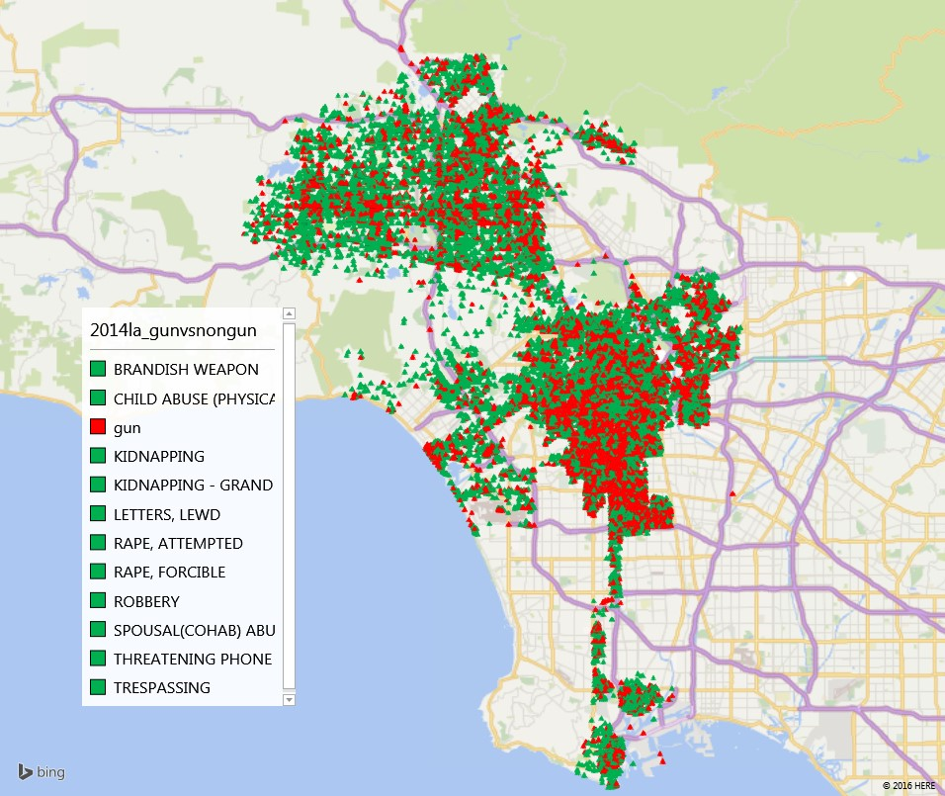
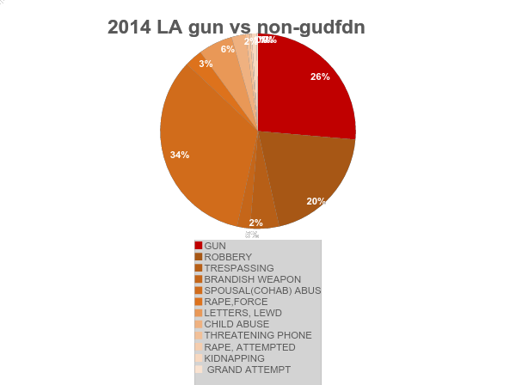
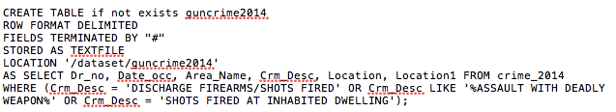
2014 LA gun vs non-gun

Slide 15
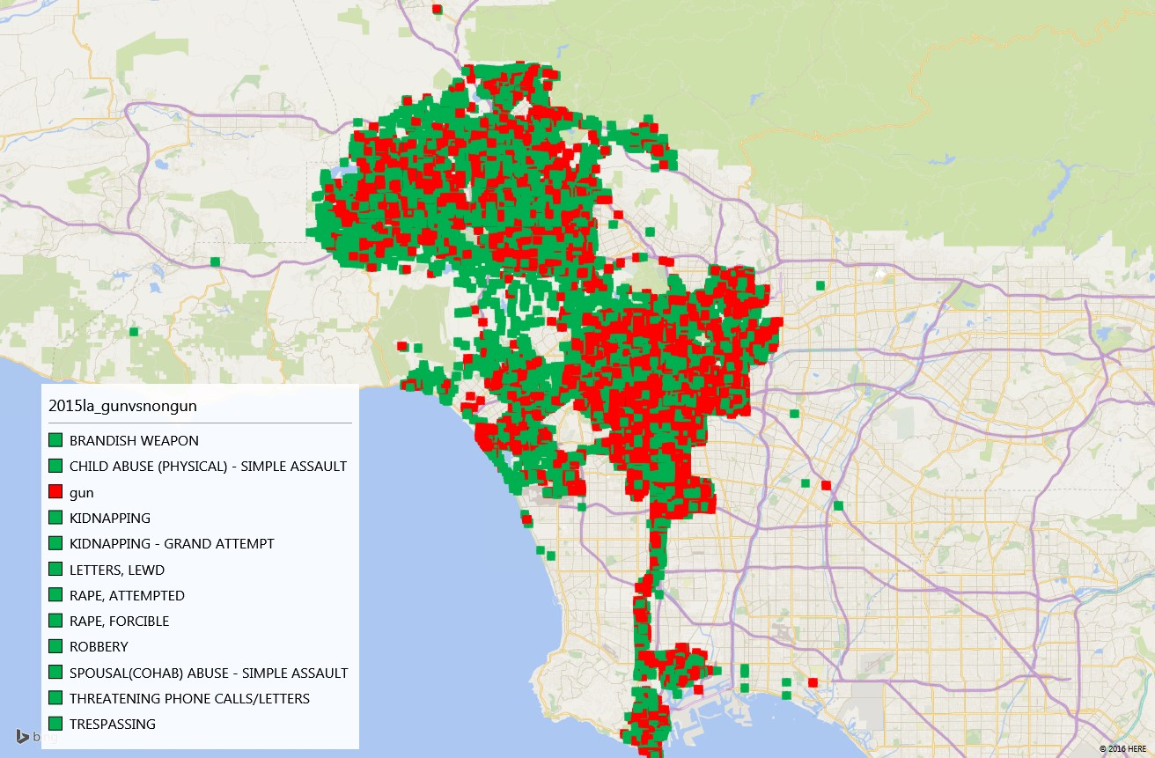
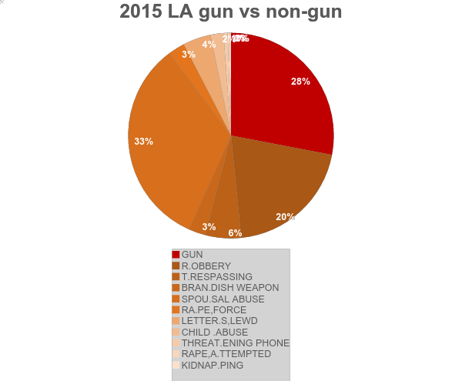

Slide 16
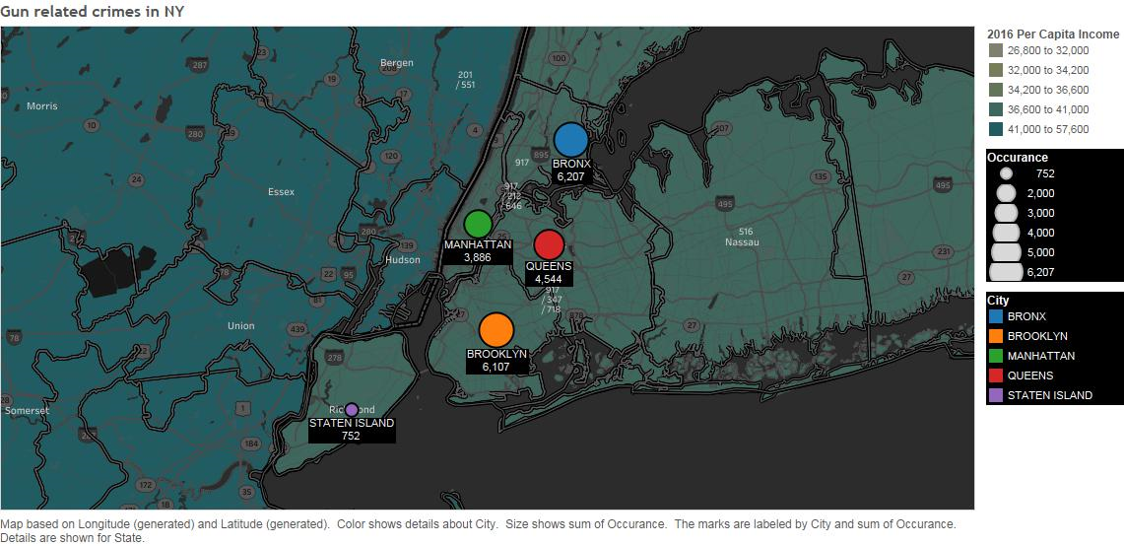
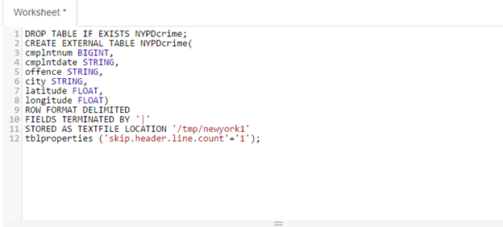
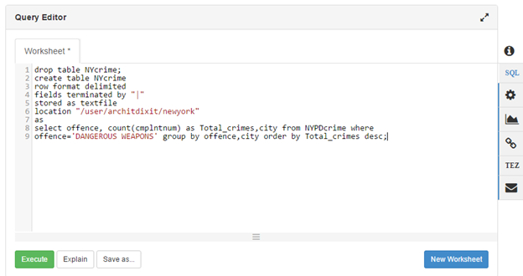
Gun related crimes in NEW YORK

Slide 17
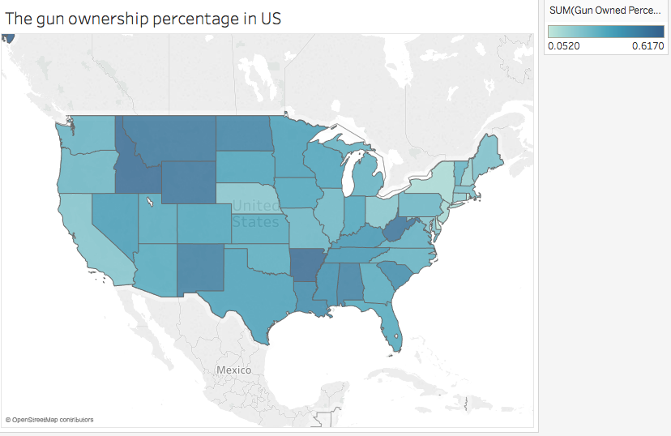
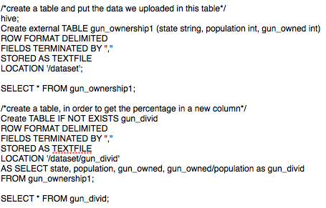
Gun ownership

Slide 18
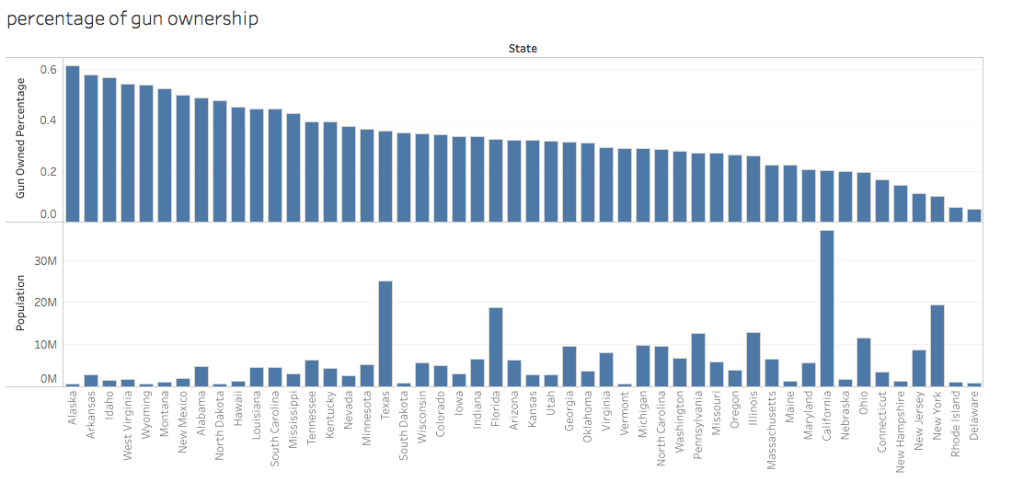
Gun ownership (cont.)
Sources from census.gov

Slide 19
Conclusion
The central LA has higher gun related crime rate than any other areas.
Gun related crimes comprised 28 % of the total number of crimes that took place in 2015.
Areas with higher per capita income reported less gun related crimes in New York.
Bronx and Brooklyn reported the highest number of gun related crimes.
The state of Missouri , Kansas and New Mexico had an increase in the gun related crimes from year 2014-2015.

Slide 20
Suggestions
Financial stability can be used to decide whether a person is more likely or less likely to use guns for any crime .

Slide 21
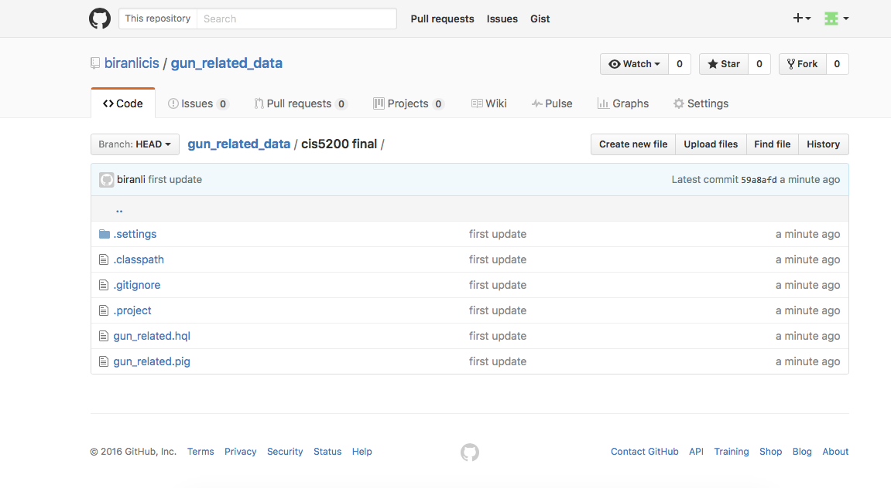
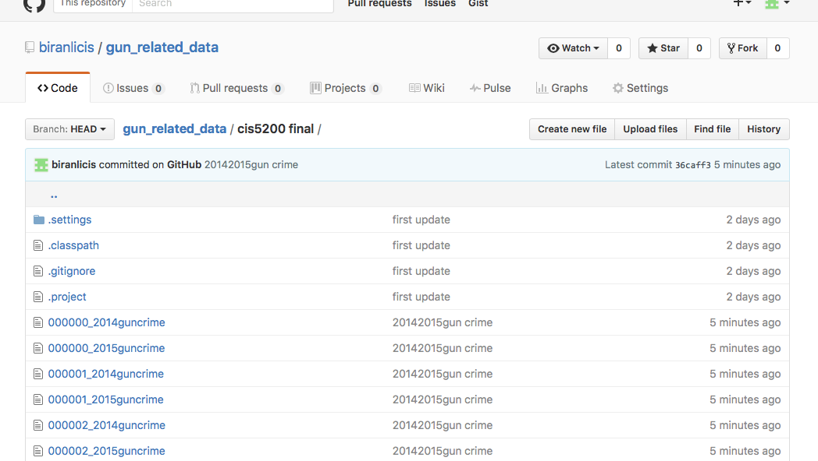
GitHub link
https://github.com/biranlicis/gun_related_data

Slide 22
Reference
Business Insider/Andy Kiersz, data from Kalesan et. al., June 2015
Median Household Income by State." United State Census Bureau. N.p., n.d. Web.
Crime in the U.S. 2014." FBI. FBI, 2015.Web. 30 Nov .2016
Crime in the U.S.2015. "FBI. FBI, 2016 Web. 30 Nov. 2016
GunDeaths. "Gun Violence Archive" Gun Violence ArchiveN.p.,n.d. Web. 30 Nov2016
National Instant Criminal Background Check System(NICS)" FBI. FBI, 2016, WEB. 30 Nov 2016
NYPD Complaint Data Historic ."NYC OpenData. 22 Nov. 2016

Slide 23
Thank you !

